Slide 1

Exploratory Data Analysis
G2M insight for Cab Investment Firm
20th September, 2024

Slide 2

Agenda
Problem Statement
Data Exploration
EDA
Recommendations

Slide 3
Problem Statement
XYZ is a private firm in US. Due to remarkable growth in the Cab Industry in last few years and multiple key players in the market, it is planning for an investment in the Cab industry and as per their Go-to-Market(G2M) strategy they want to understand the market before taking final decision.
OBJECTIVE
To provide insights to help XYZ identify the right company to make their investment.

Slide 4
Data Exploration
4 datasets were provided and they were joined to create a master dataset with 18 columns & 359,392 observations
Time period of the dataset: 31/01/2016 to 31/12/2018
The dataset was explored to evaluate which cab company would be a better pick for an investment.
Key factors such as financial performance, market dominance and customer demographics were analyzed to provide insights.

Slide 5
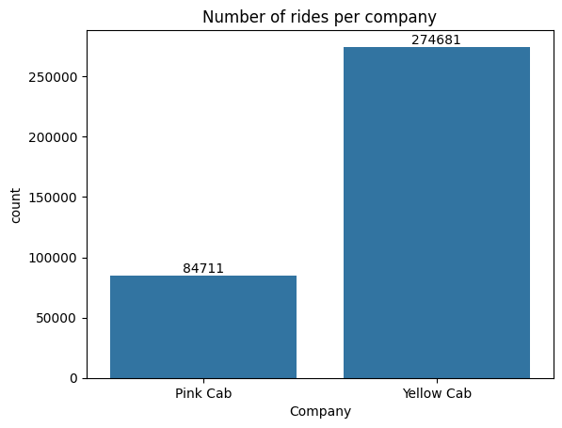
Number of rides per company
The Yellow Cab Company has a significantly larger share of the number of rides in the dataset.
This indicates that yellow cabs are likely the preferred choice among customers.

Slide 6
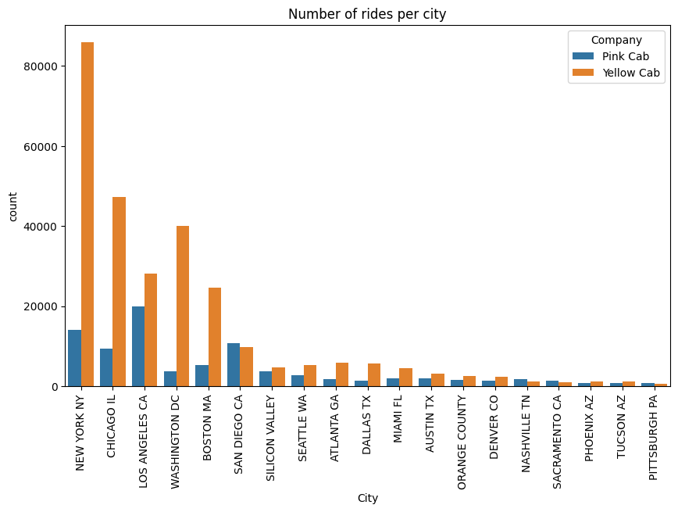
Number of rides per city
Yellow cabs have much larger presence in most of the cities, especially the major urban areas.
This dominance of yellow cabs across multiple cities further indicates a larger market share and higher customer preference.

Slide 7
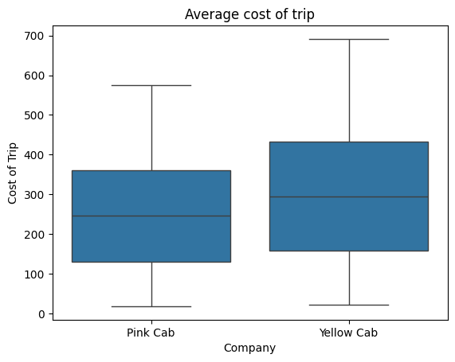
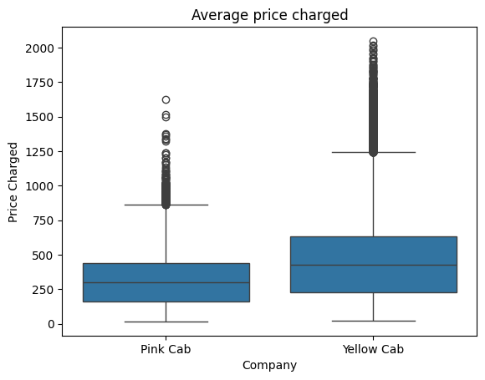
Cost of trips and Price Charged
On average, trips covered by the Yellow Cabs cost more on average and the average price charged for trips by the Yellow Cabs are higher.

Slide 8
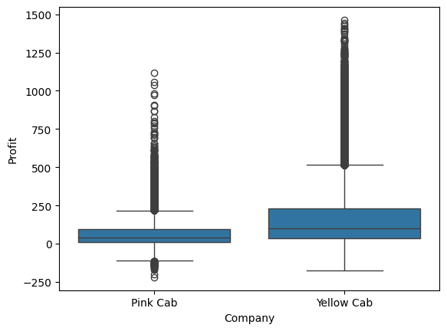
Profit analysis
The Yellow Cab company is generating significantly higher profits compared to the Pink Cab company, suggesting yellow cabs have more profitable rides.

Slide 9
Average Transaction Per Customer
COMPANY | Number of Customers | Number of Transactions | Average transaction per Customer
PINK CAB | 32330 | 84711 | 3
YELLOW CAB | 39896 | 274681 | 7
Yellow cabs having more transactions per customer implies higher customer retention, stronger customer loyalty and a larger market share.

Slide 10
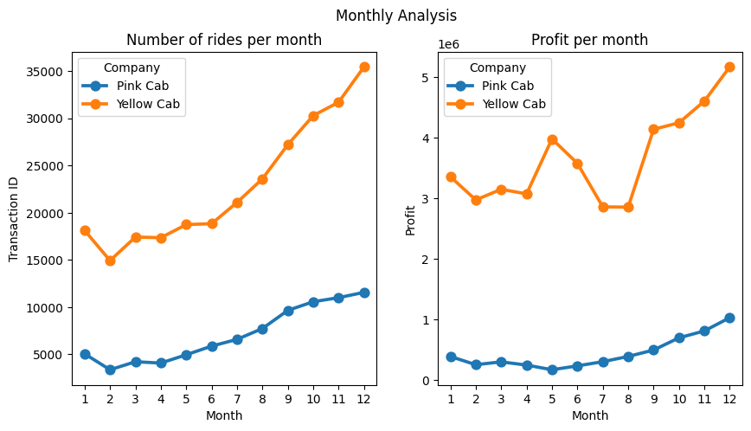
Monthly Analysis
Yellow Cab dominates both in the number of rides and profit throughout the year.
Yellow cabs also seem to benefit more from peak months, although the profitability is more volatile
Pink Cabs on the other hand have slower but steady increases in profit and number of rides throughout the year.

Slide 11
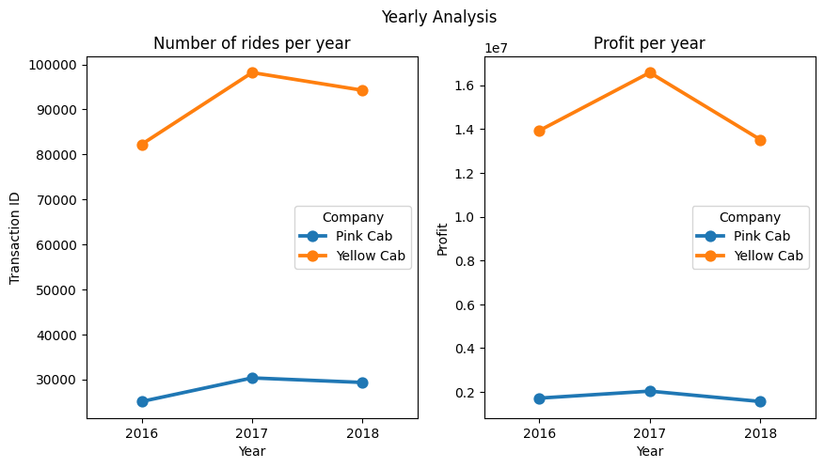
Yearly Analysis
For both companies, the highest number of rides and highest amount of profit was realized in 2017 and there was a slight decline between 2017 and 2018

Slide 12
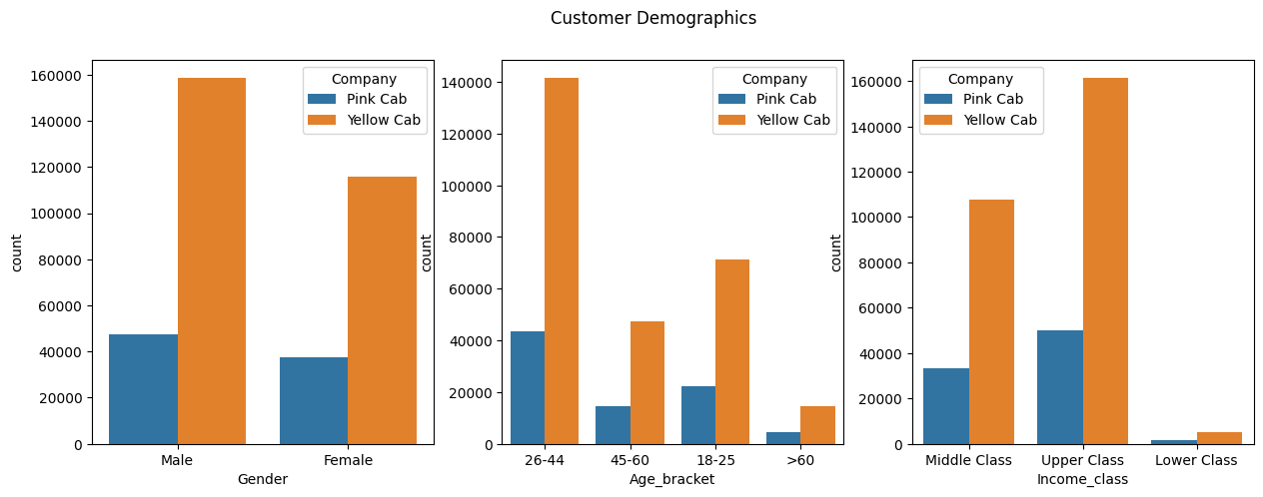
Customer demographics
The Yellow cab company serves a much larger customer base across all demographics.
For both companies, Males, the 26-44 age group, and upper class income bracket are the largest customer segments, indicating that these are key target demographics for cab services.

Slide 13
Recommendations
Based on the analysis done on both cab companies, the Yellow Cab seems to be a better investment option due to:
A significantly larger market share
Higher customer retention
Greater profit margins
Stronger presence in major cities and across various customer segments.

Slide 14
Thank You

